Slide 1
Bottle Opener
Oh, I found it on the ground
Omar Elsewify
November 4th 2020

Slide 2
Final Design Choices

Slide 3
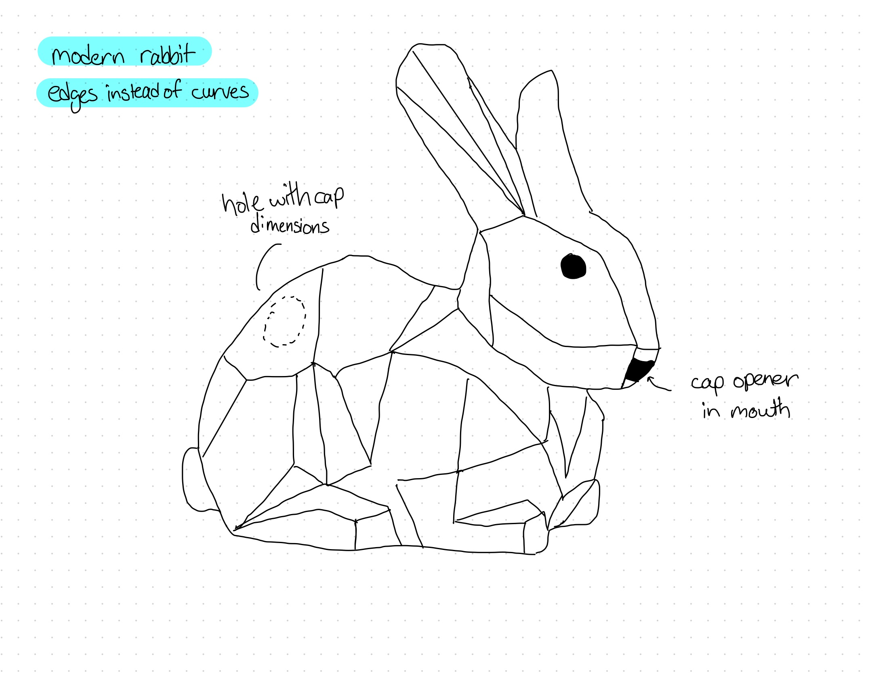
Bunny rabbit with leverage point opener in the mouth and screw opener in the rear side

Slide 4
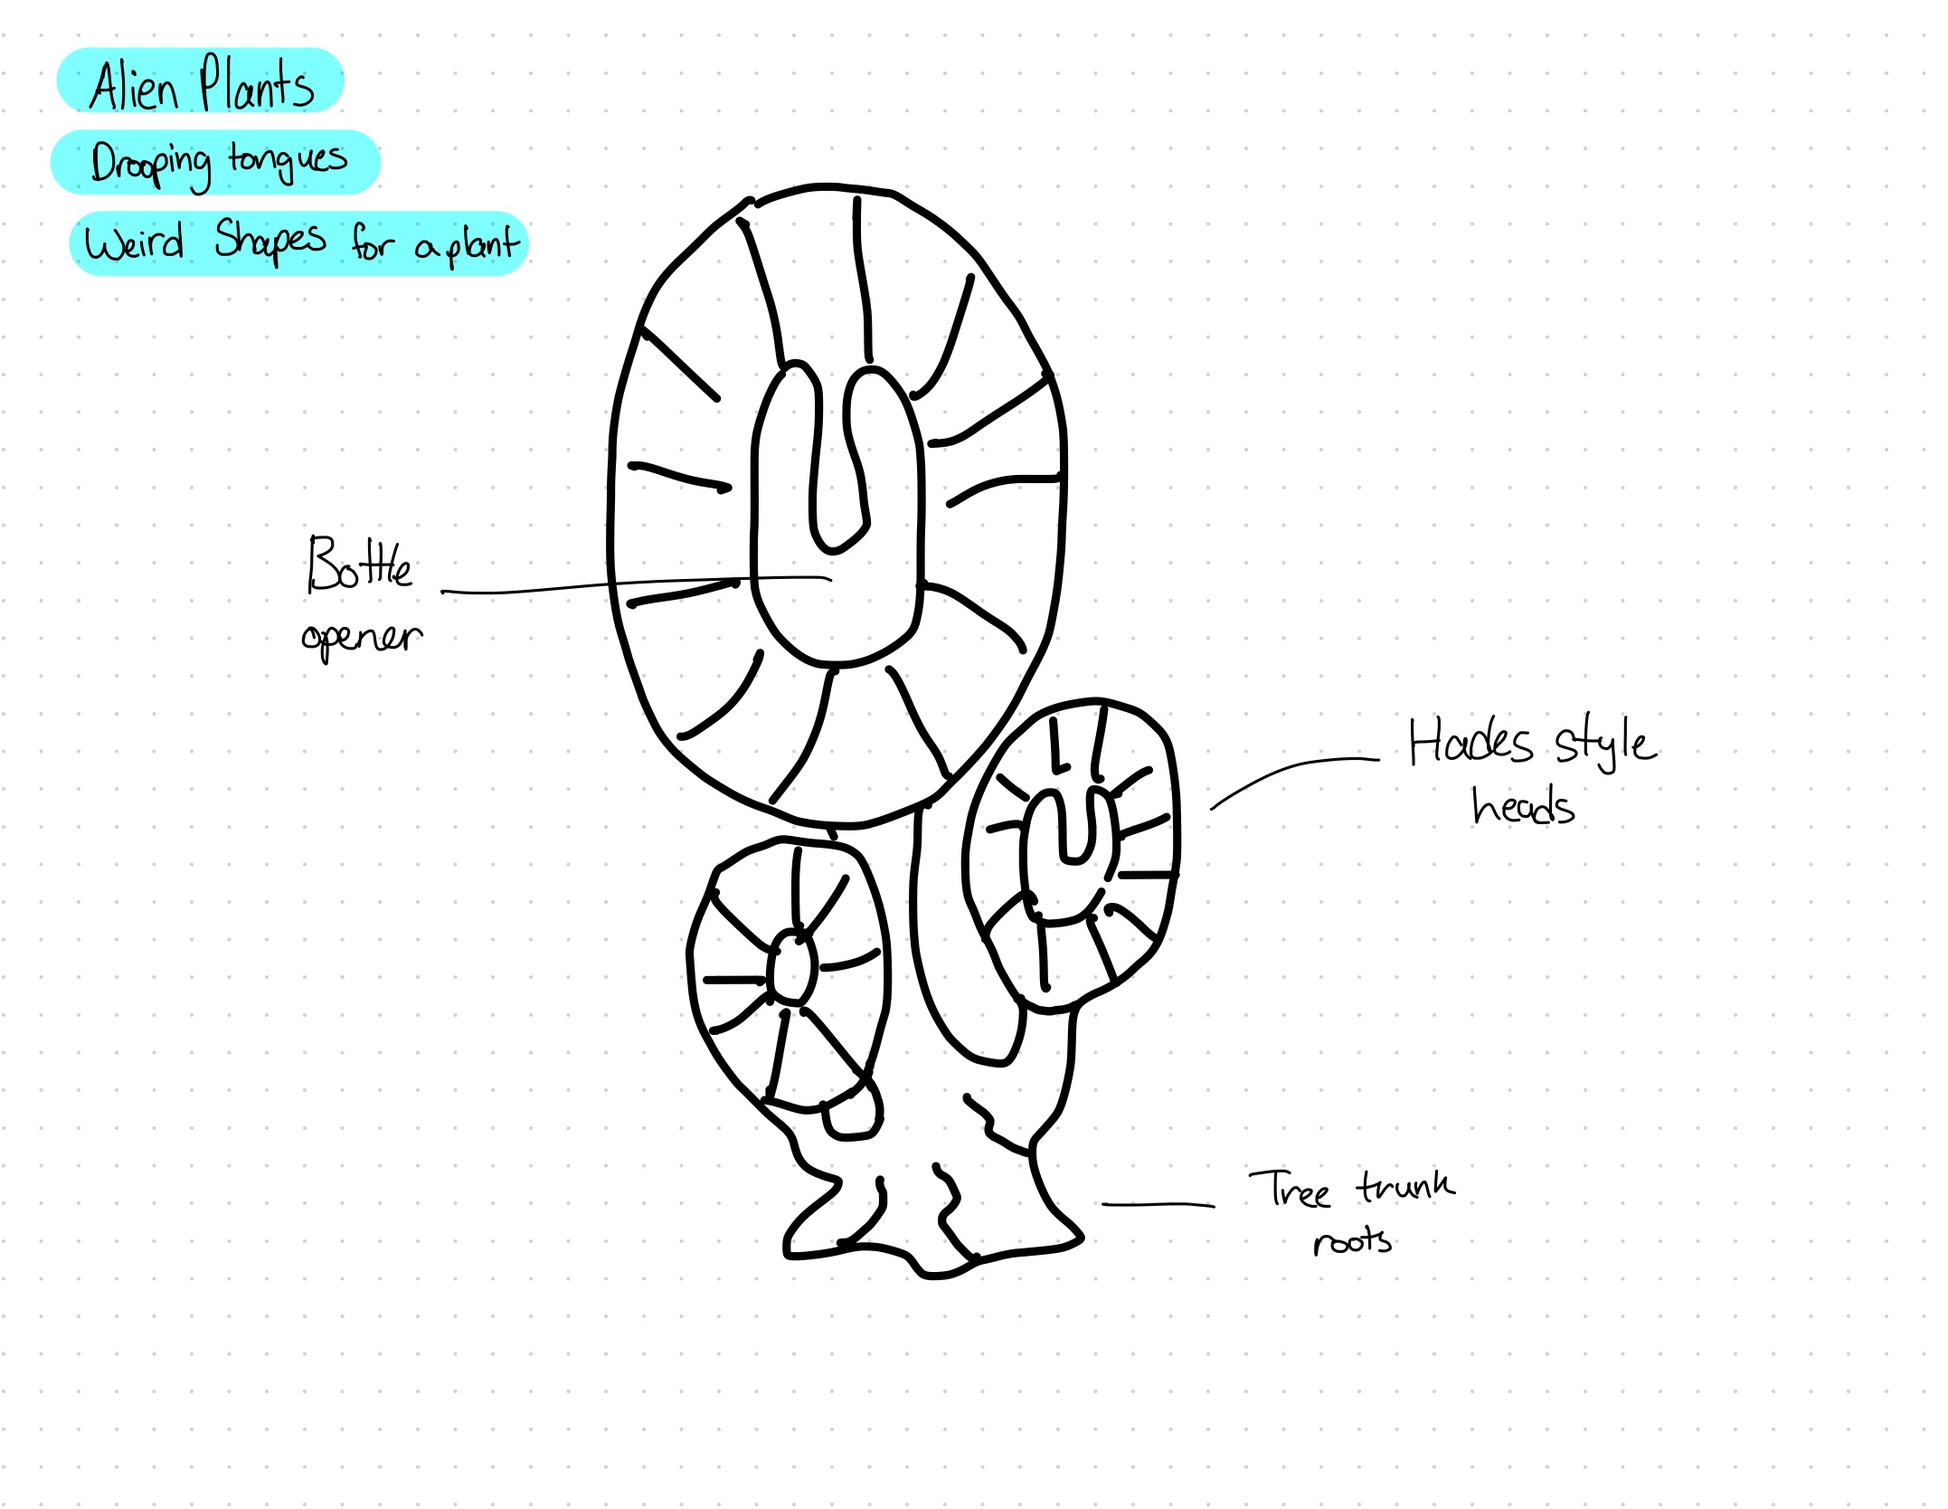
Alien Plants with bottle opener in the largest head

Slide 5
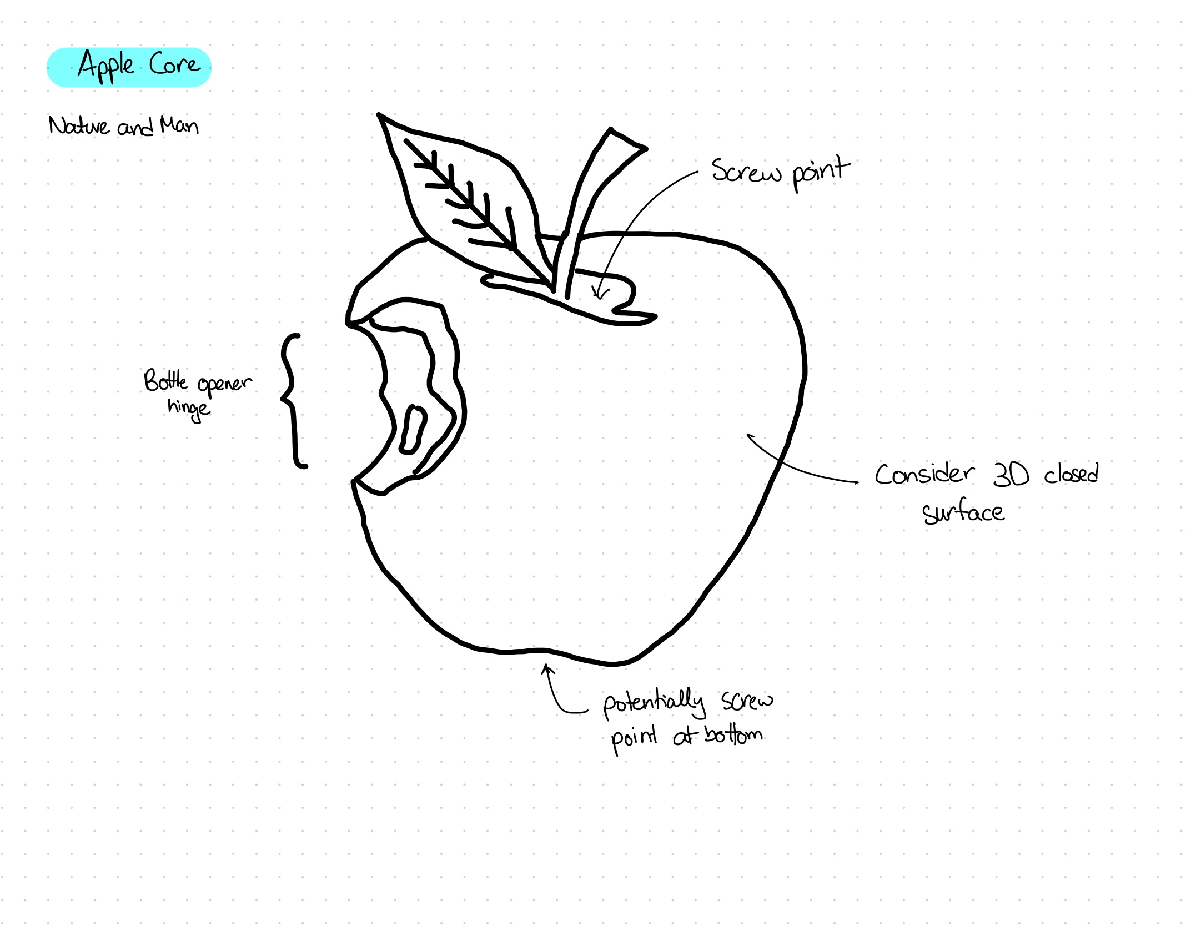
Apple core opener with stem or bottom being screw opener points and the bite being a leverage point

Slide 6
Process Story

Slide 7
Day 1
Thinking Outside
Previously I was not a fan of sitting outside to design because I don’t enjoy being affected by the elements
Thinking outside leads me to more natural shapes and designs
I found things that otherwise would never have crossed my mind
Wednesday 16:18 -17:10

Slide 8
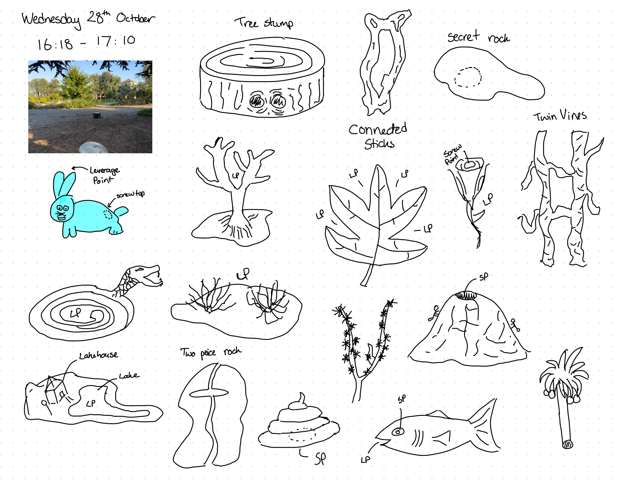
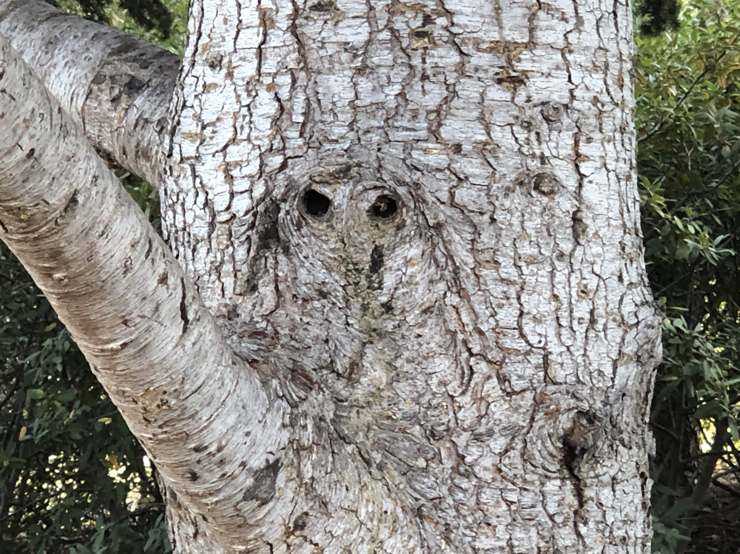
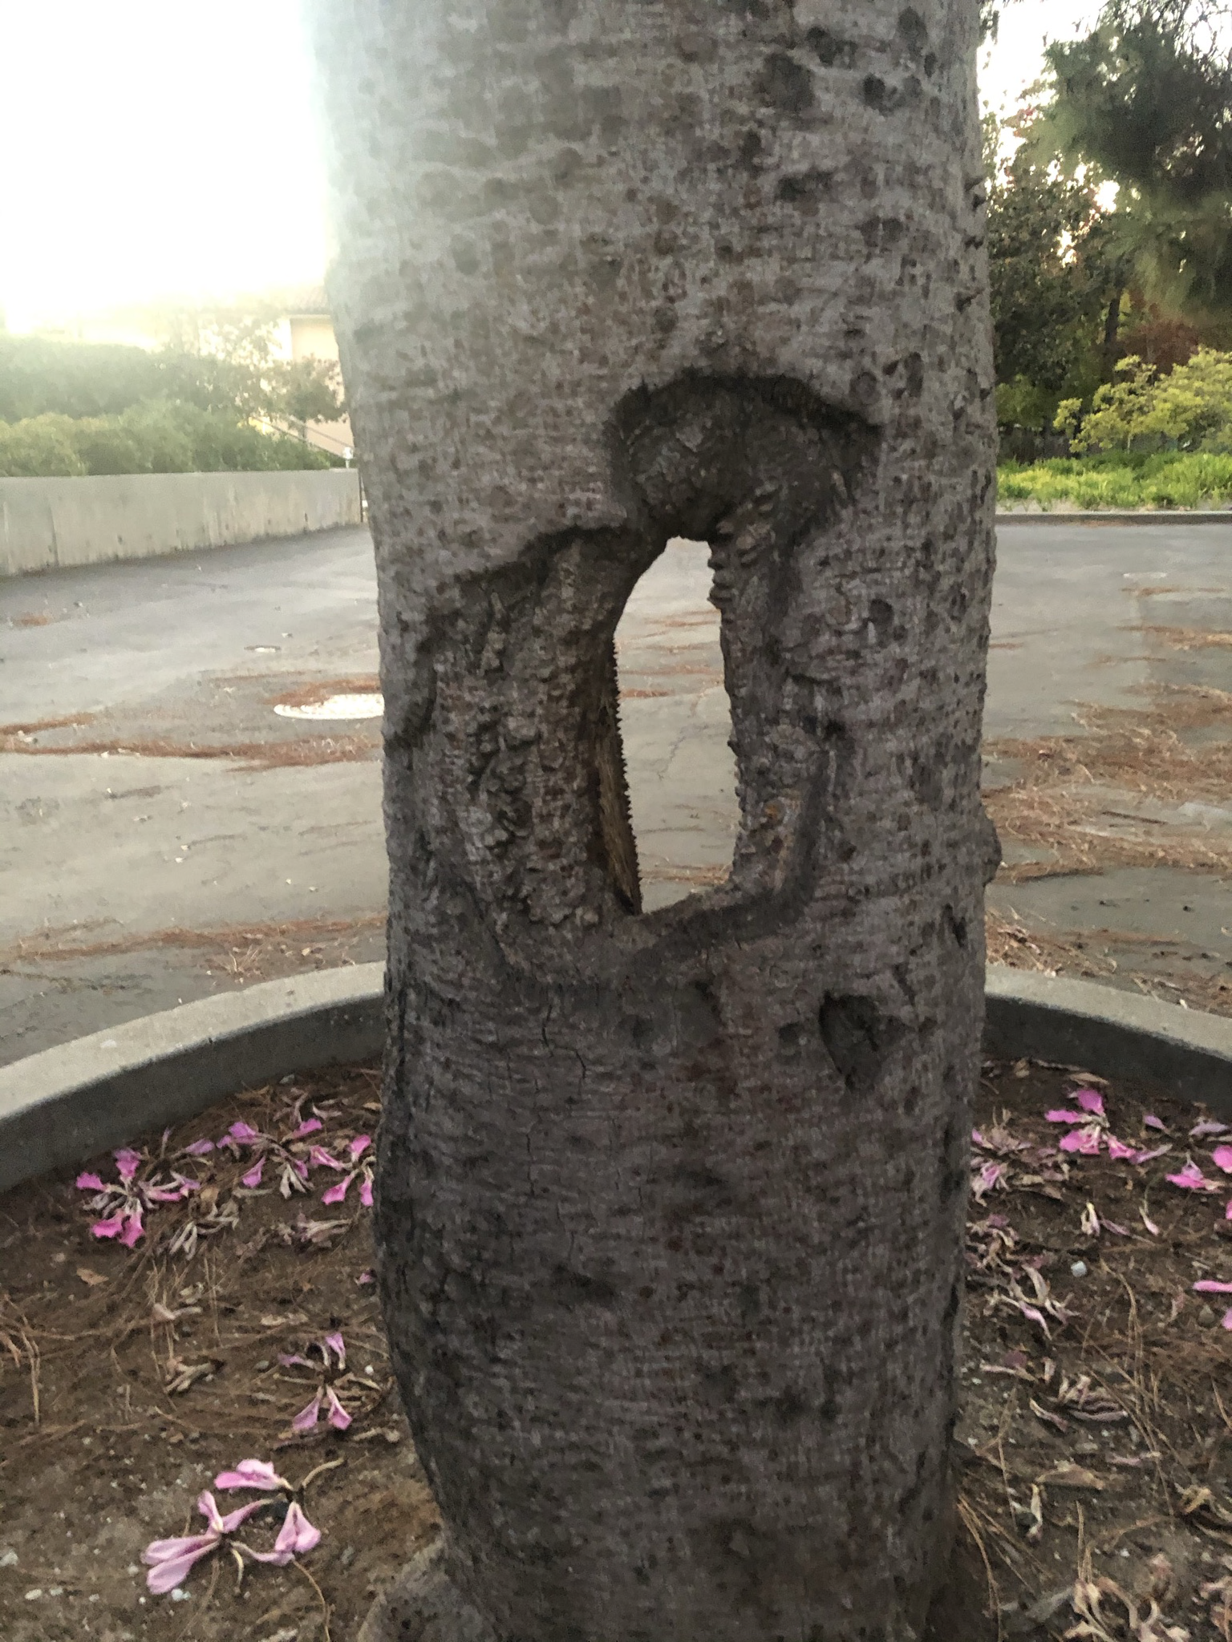
Drawings from the outdoor thinking session

Slide 9
Day 2
In bed designing
Wrote down a list of stimulant words to help me redirect me to new ideas
Tried to iterate the designs created the day before
Thursday 20:45 - 21:30

Slide 10
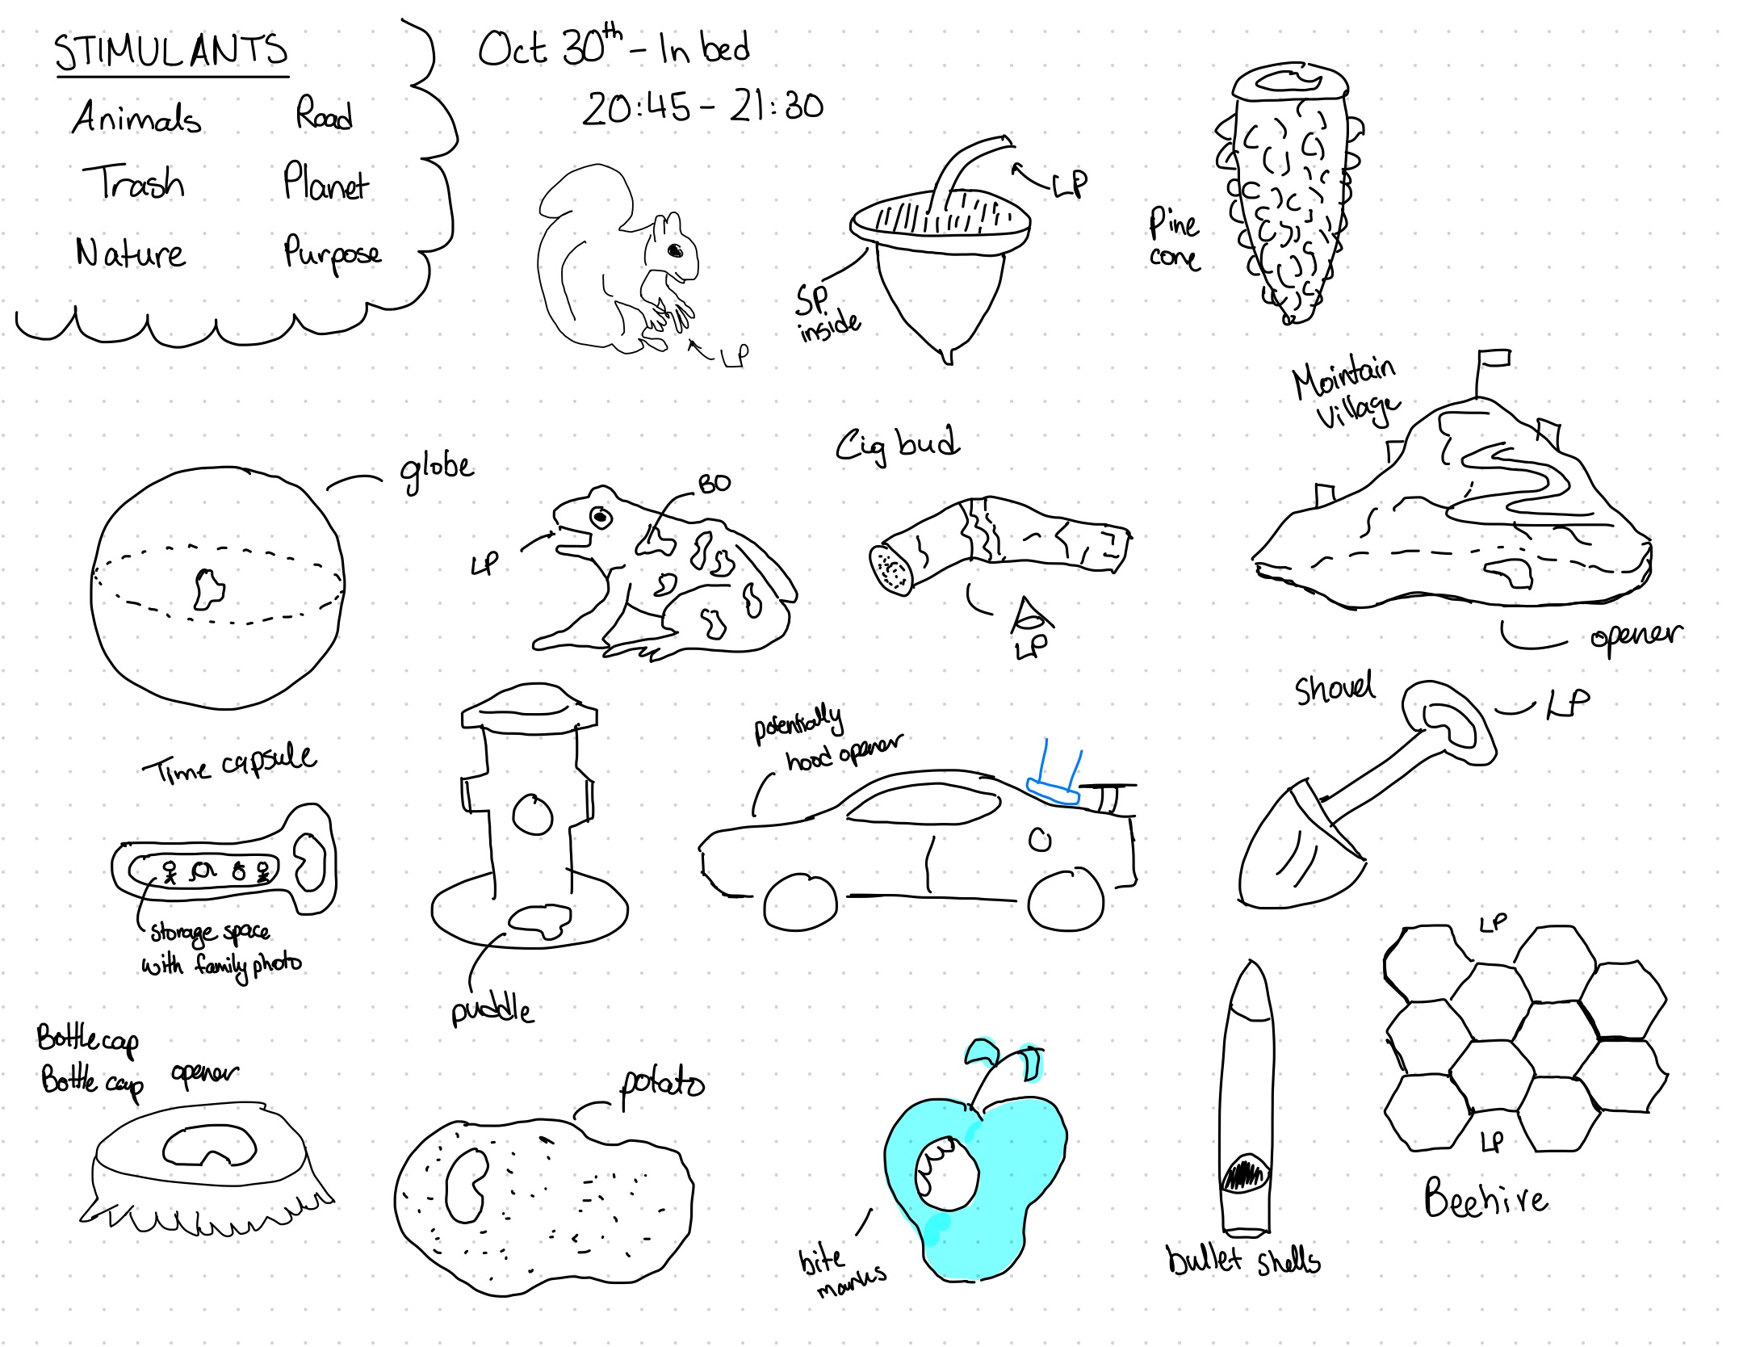
Day 2 designs created on Thursday night design session

Slide 11
Day 3
Laying in the ground
Lied on carpet of my apartment, in an attempt to see more things hidden in the floor
Didn’t like it so I got up and sat at my desk to continue
Friday 18:45 - 19:25

Slide 12
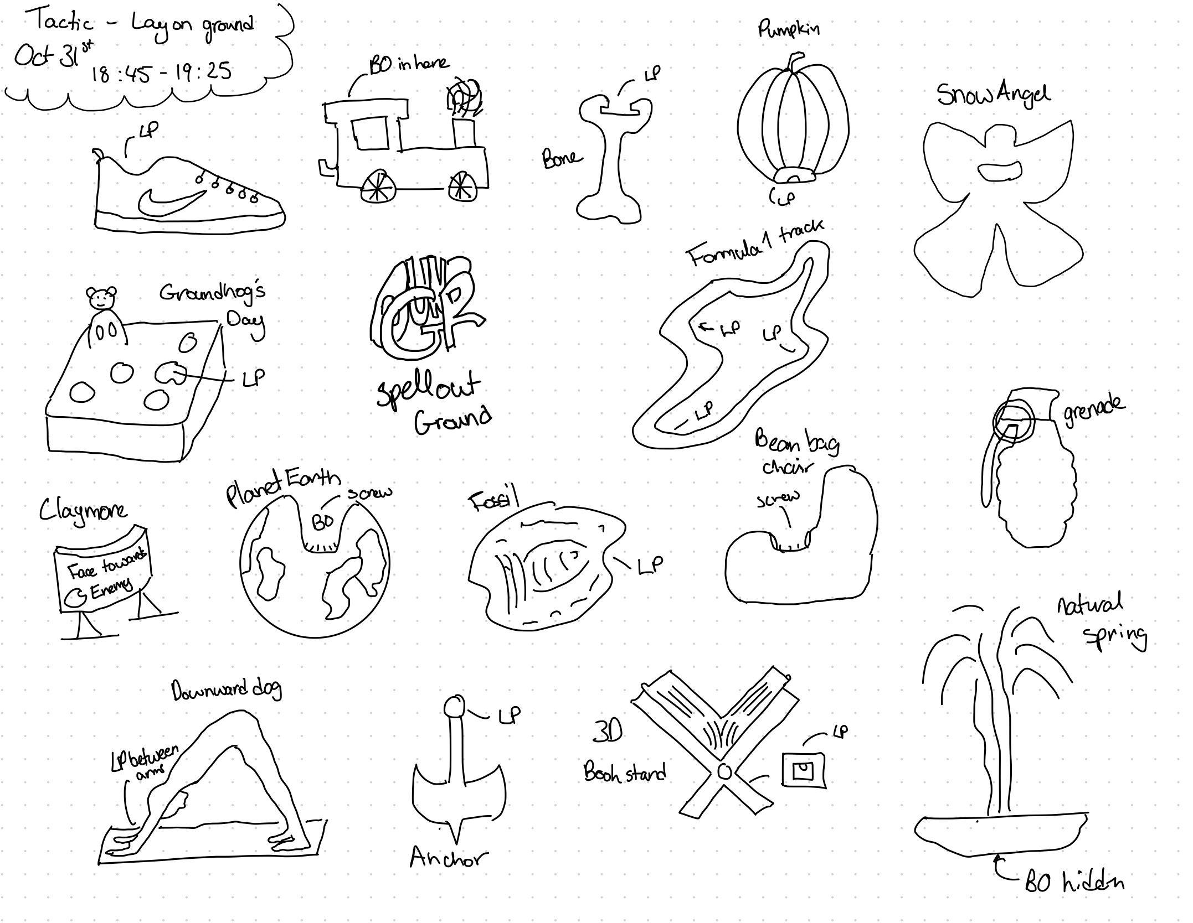
Drawings and concepts created after laying on the ground for a few minutes

Slide 13
Day 4
Random Generator
Used artprompts.org to generate random prompts about objects
This worked really well, I came up with some outside the box ideas that otherwise wouldn’t have crossed my mind
I like how it forced me into new ideas
Sunday Night at my desk

Slide 14
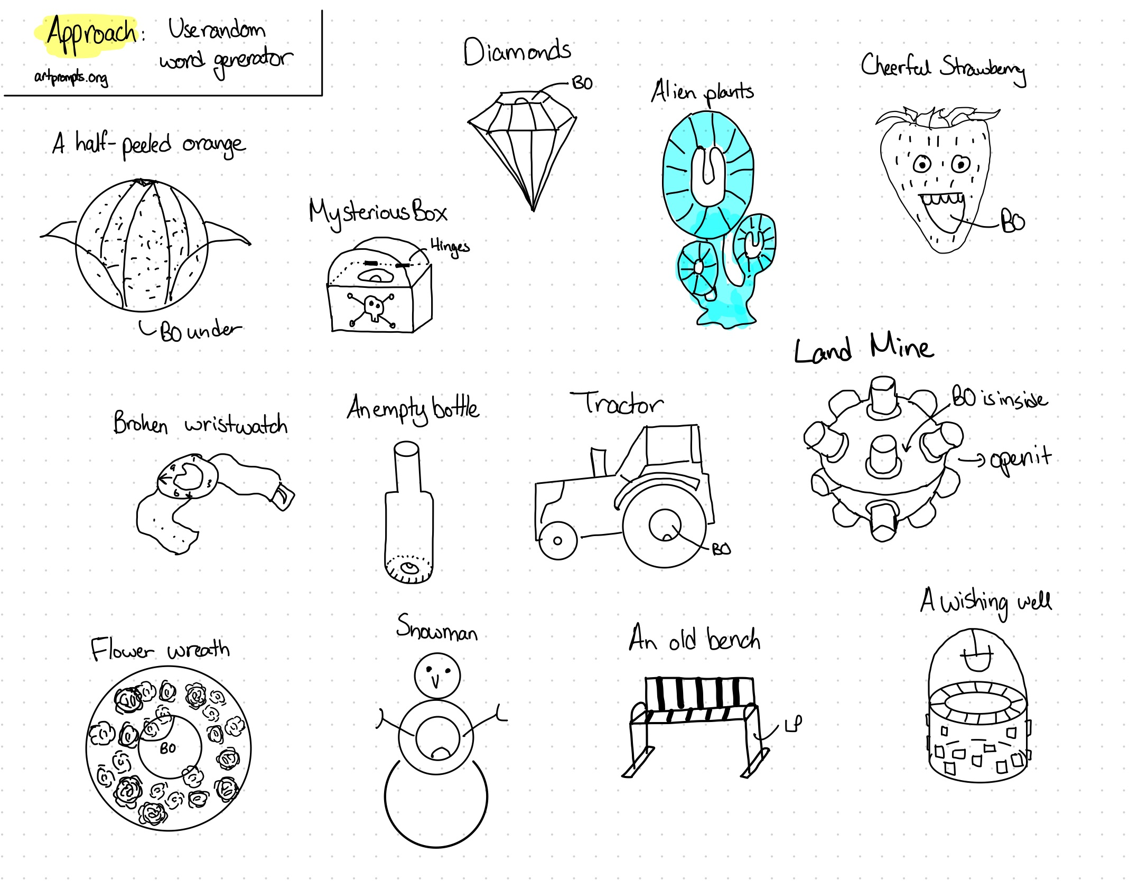
Day 4 designs created using random prompts from an online site

Slide 15
Day 5
Post Walk Clarity
Designing concepts after going for a walk to pick up dinner
Tried to look for outstanding things on the ground which I did not expect
I also looked at man made things vs natural objects
Monday Night 19:00 - 20:00

Slide 16
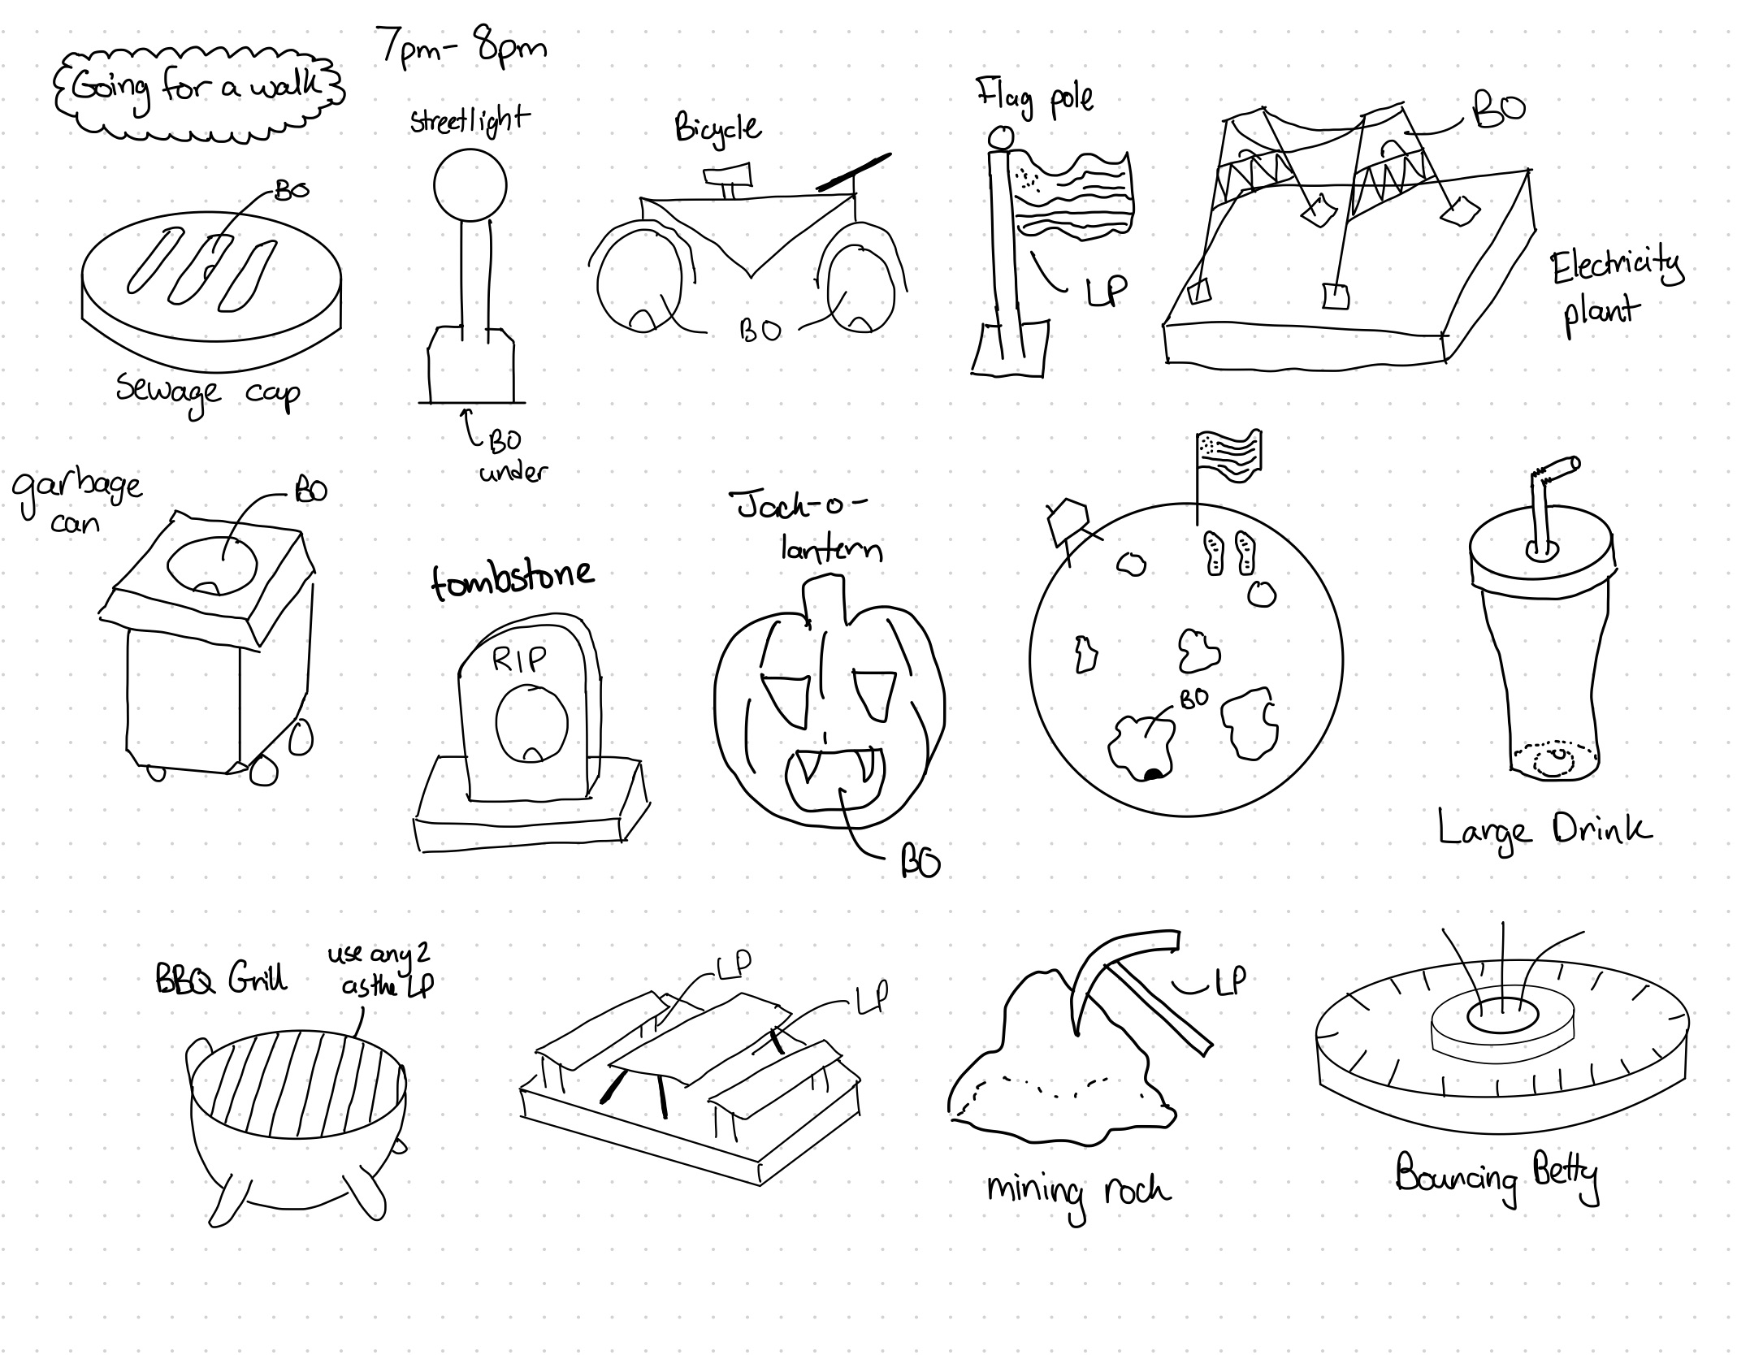
Concepts that I came up with after going for a walk around campus

